Slide 1
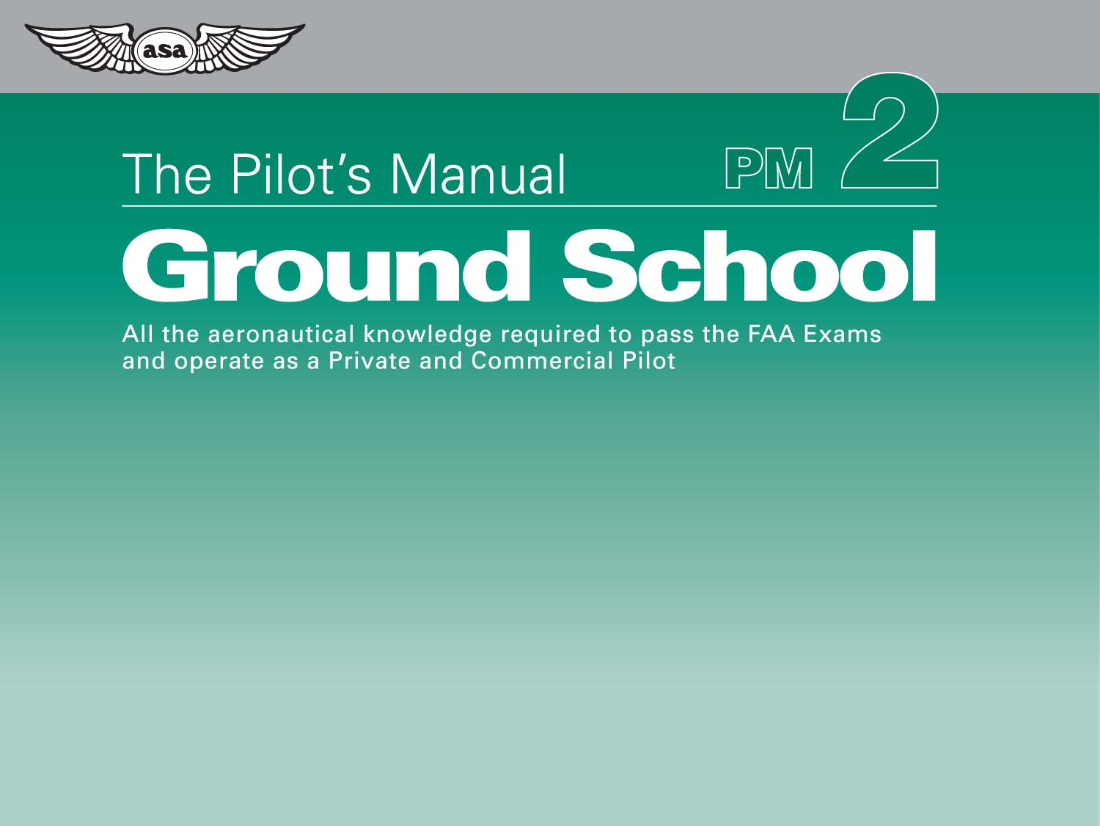
The Airplane
Chapter 6
Systems

Slide 2
Figure 6-1. Simple carburetor fuel system.

Slide 3
Figure 6-2. Typical fuel injection system.

Slide 4
Figure 6-3. Fueling from a tanker.

Slide 5
Table 6-1. Fuel grades.

Slide 6
Figure 6-4. Fuel drains are located at the lowest point of the fuel tanks.

Slide 7
Figure 6-5. Fuel check.

Slide 8
Figure 6-6. Typical light airplane electrical system.

Slide 9
Figure 6-7. The left-zero ammeter.

Slide 10
Figure 6-8. The center-zero ammeter.

Slide 11
Figure 6-9. The master switch (battery switch/alternator switch).

Slide 12
Figure 6-10. Low-amp relay circuit activates high-amp starter circuit.

Slide 13
Figure 6-11. Gyroscope buckets.

Slide 14
Figure 6-12. A typical vacuum system.

Slide 15
Figure 6-13. A typical venturi tube.

Slide 16
Figure 6-14. Air flowing through a venturi tube can create a “suction”, and power a vacuum system.

