Slide 1
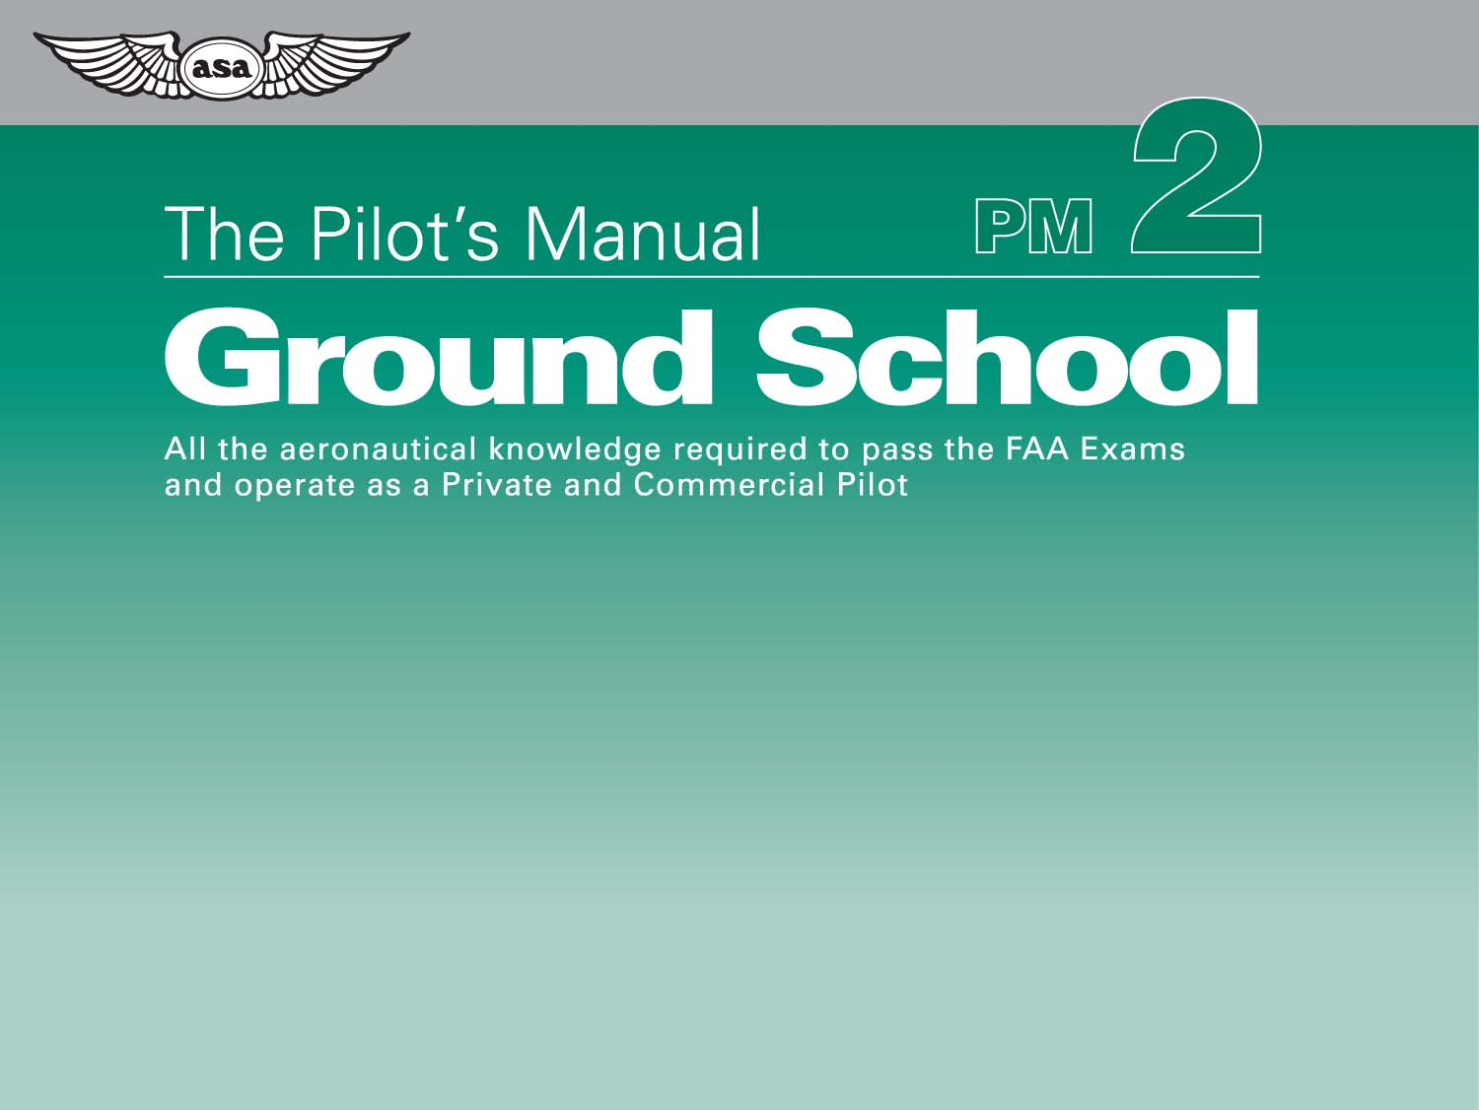
Flight Operations
Chapter 26
En Route Navigation

Slide 2
Figure 26-1. Tracking error is the angular difference between the desired course and the ground track.

Slide 3
Figure 26-2. Tracking error results if WCA is greater or lesser than actual drift.

Slide 4
Figure 26-3. In-flight modification of HDGs and ETEs is usual in en route navigation.

Slide 5
Figure 26-4. Method 1: Setting course overhead.

Slide 6
Figure 26-5. Method 2: Setting course en route and calculating ATD.

Slide 7
Figure 26-6. Check approximate course direction soon after departure.

Slide 8
Figure 26-7. Long, narrow features are particularly useful to parallel.

Slide 9
Figure 26-8. Obtain a check on GS and tracking early in the cruise.

Slide 10
Figure 26-9. Confirm identification of your selected feature by its relationship with other features.

Slide 11
Figure 26-10. Long, narrow features are particularly useful for groundspeed checks.

Slide 12
Figure 26-11. Each of these airplanes is on the same position line.

Slide 13
Figure 26-12. Marking a position line.

Slide 14
Figure 26-13. Two position lines with a good cut can give you a fix.

Slide 15
Figure 26-14. Look for a definite feature at a definite time.

Slide 16
Figure 26-15. Fold and orient the chart in the cockpit prior to departure.

Slide 17
Figure 26-16. Groundspeed check using position lines perpendicular to track.

Slide 18
Figure 26-17. GS check using radio position lines from abeam navigation beacons (NDBs and VORs).

Slide 19
Figure 26-18. Determining drift angle from position lines parallel to track.

Slide 20
Figure 26-19. Tracking error and closing angle.

Slide 21
Figure 26-20. The angles of an equal-sided triangle are each 60°.

Slide 22
Figure 26-21. Halving angles as a means of estimating track.

Slide 23
Figure 26-22. The top thumb-joint covers approximately 10 NM at 1:500,000.

Slide 24
Figure 26-23. A full hand span is approximately 60 NM on a 1:500,000 chart.

Slide 25
Figure 26-24. The built-in personal 1-in-60 measuring device for 10°.

Slide 26
Figure 26-25. Method 1: estimating the “most probable area” that you are in.

Slide 27
Figure 26-26. Method 2 for estimating “most probable position”.

Slide 28
Figure 26-27. Estimating distances using sight-down angle 45° below the horizon.

